Slide 1

NQR Finances
WSS: Nelson Cowan, Quinn Thompson, Reid Pezewski

Slide 2
Financial Literacy in the US
Only 40% of four year students have joined a personal financial course
Difficult for working class adults to keep up with/understand financial literacy concepts
Lower income consumers lack the exposure to and understanding of financial literacy concepts
However...
85% of Americans have a smart device

Slide 3
NQR Finances
Financial Literacy Social Media

Slide 4
What’s Our Scope?
Outreach to two target populations:
Individuals without immediate expendable income who want to learn more about financial literacy
Demographics that either are beginning to learn about/have not been exposed to information on financial literacy
Accessible Anywhere
Notes:
Individuals without immediate expendable income who want to learn more about financial literacy
Demographics that either are beginning to learn about/have not been exposed to information on financial literacy
Underbanked individuals/those who lack credit score
People unable to invest at all
People at the beginning of investing
Who want to learn - It’s like my dad always says, I can only help you if you want to help yourself. I want the best for you but you have to take advantage of it, and while we can encourage you to take the right path it is your choice in the end on what to do.

Slide 5
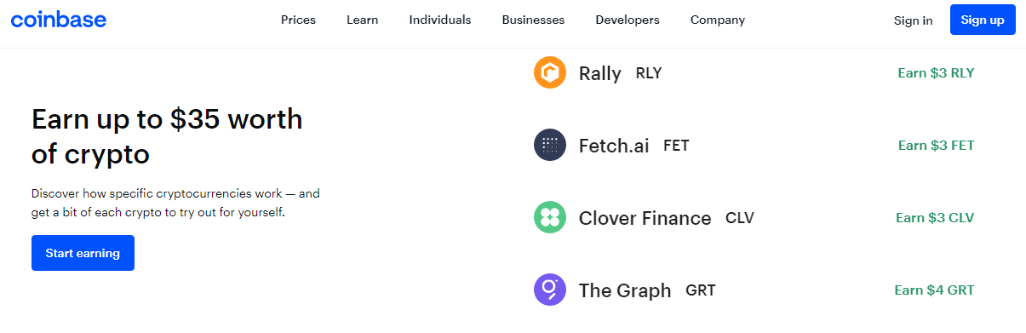
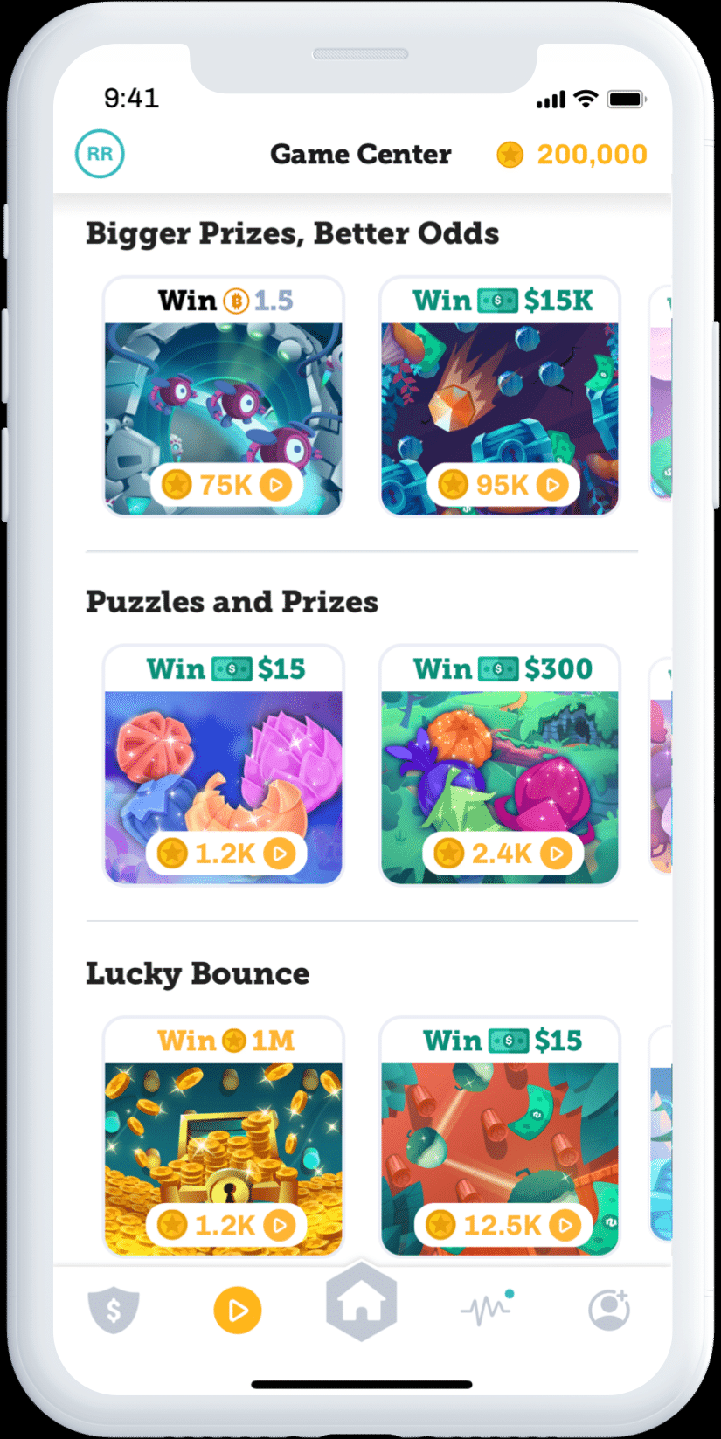


Inspirations
Notes:
Coinbase’s opportunities to earn crypto by taking lessons on Coinbase
Gamification of Learning in lonbase
Mascot helping with learning

Slide 6
NQR Finances:
Social Media That Works For YOUR Money!

Slide 7


My Feed

Slide 8
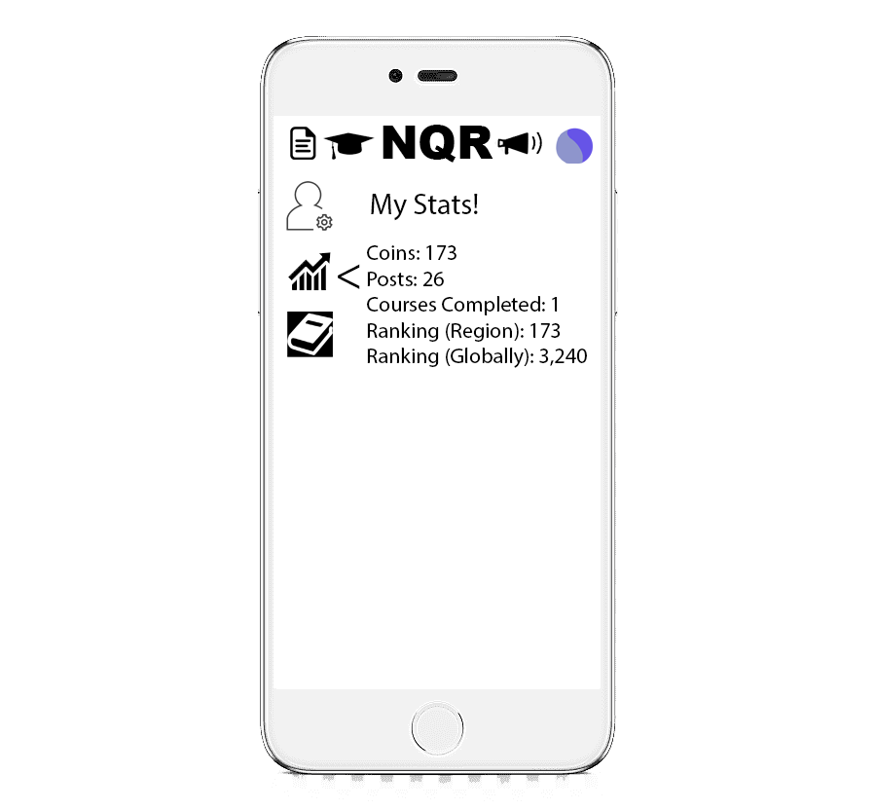
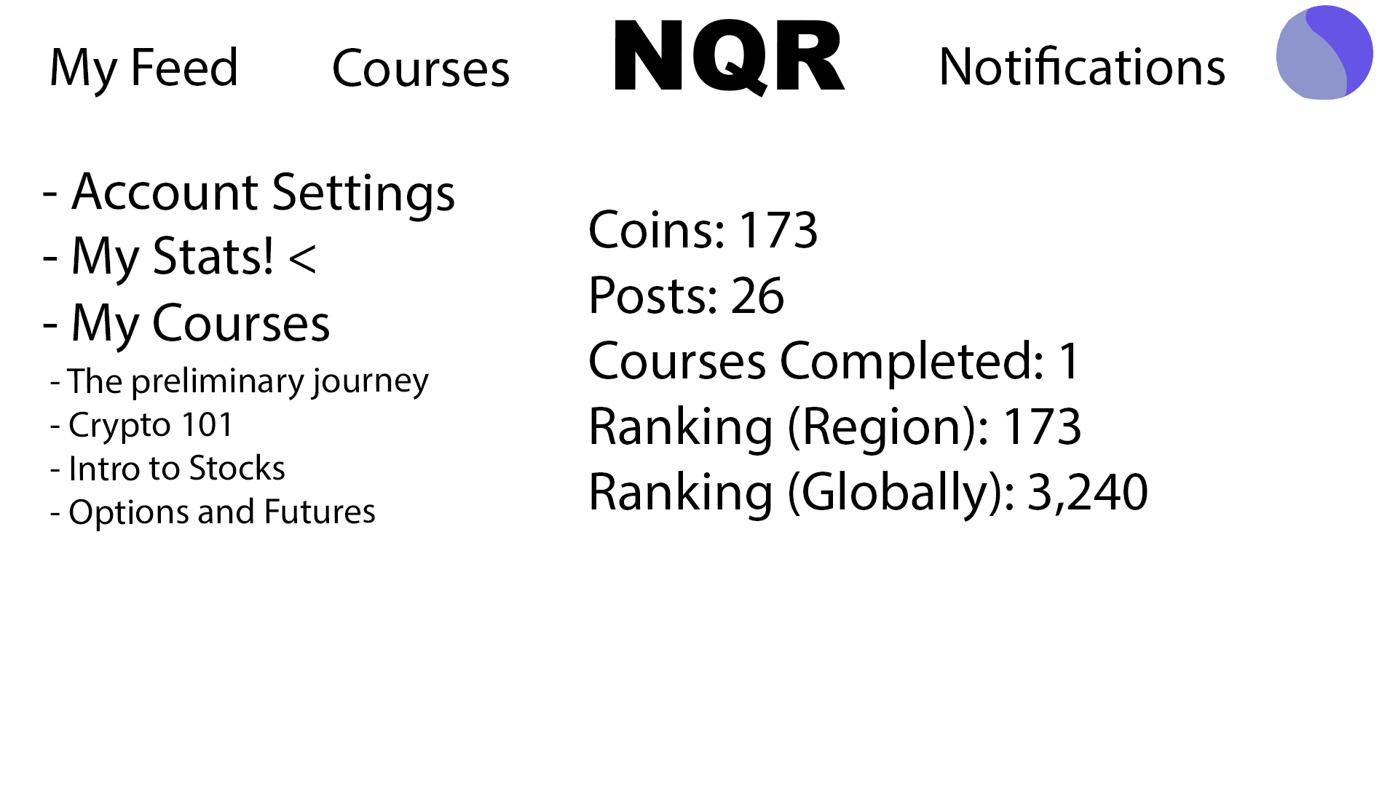
User Profile

Slide 9


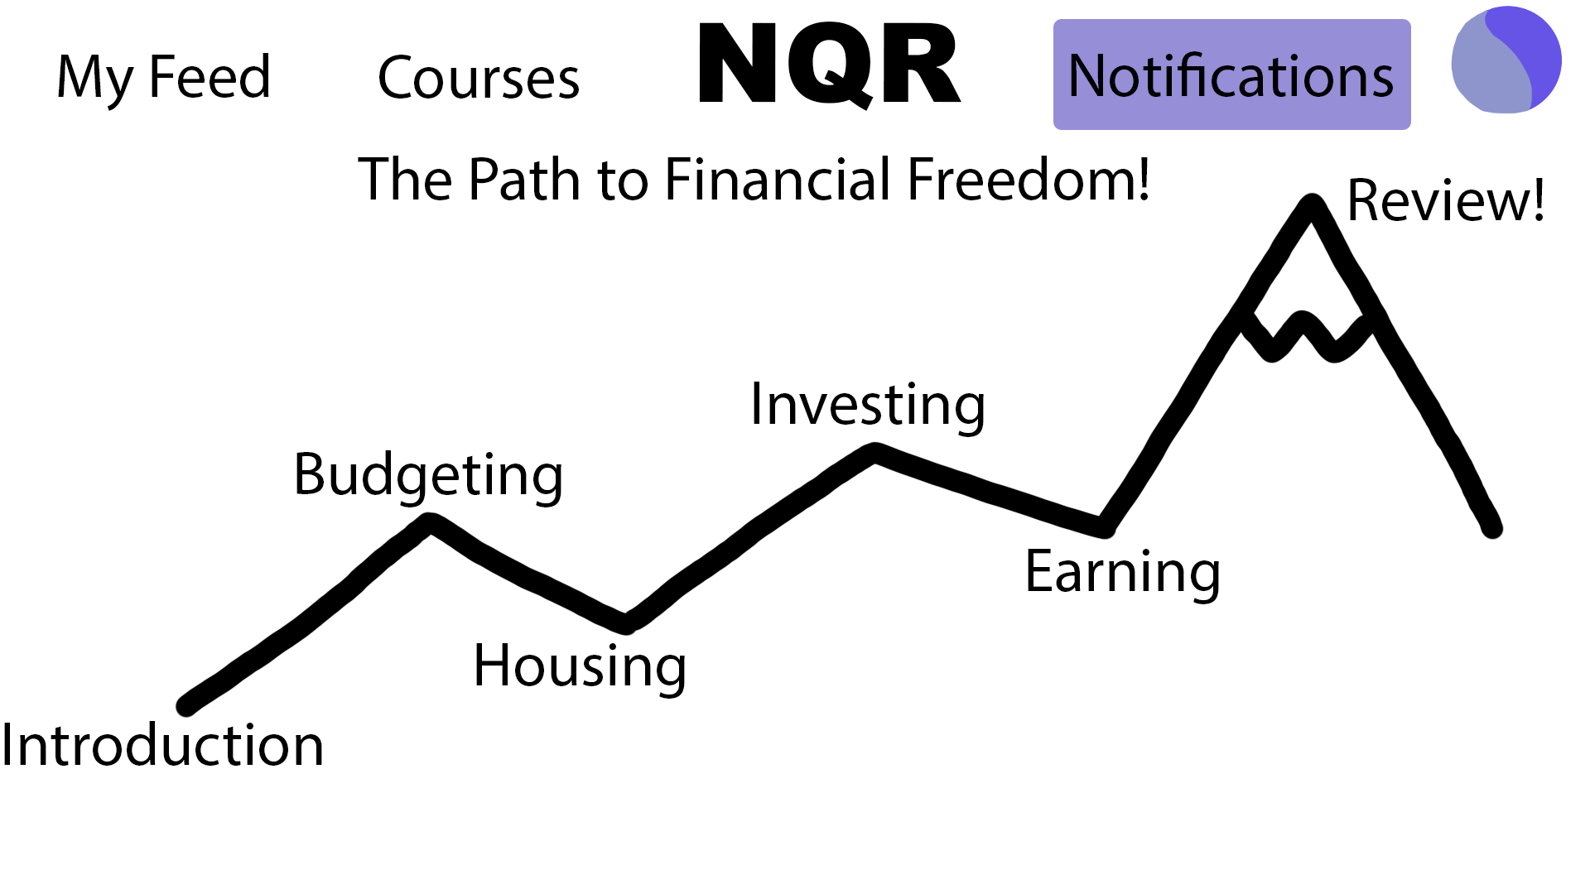
Preliminary Course

Slide 10

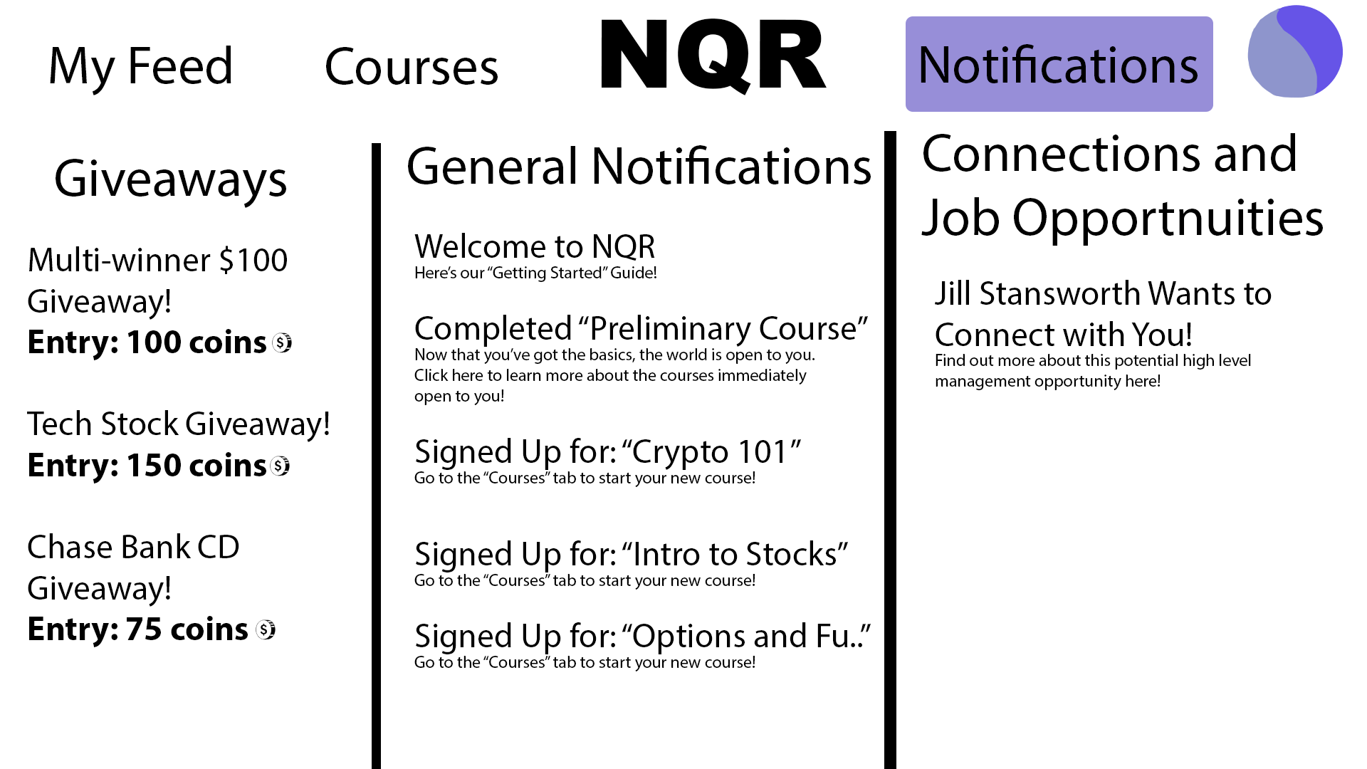
Notifications

Slide 11
Important Topics to Consider in Financial Literacy

Slide 12
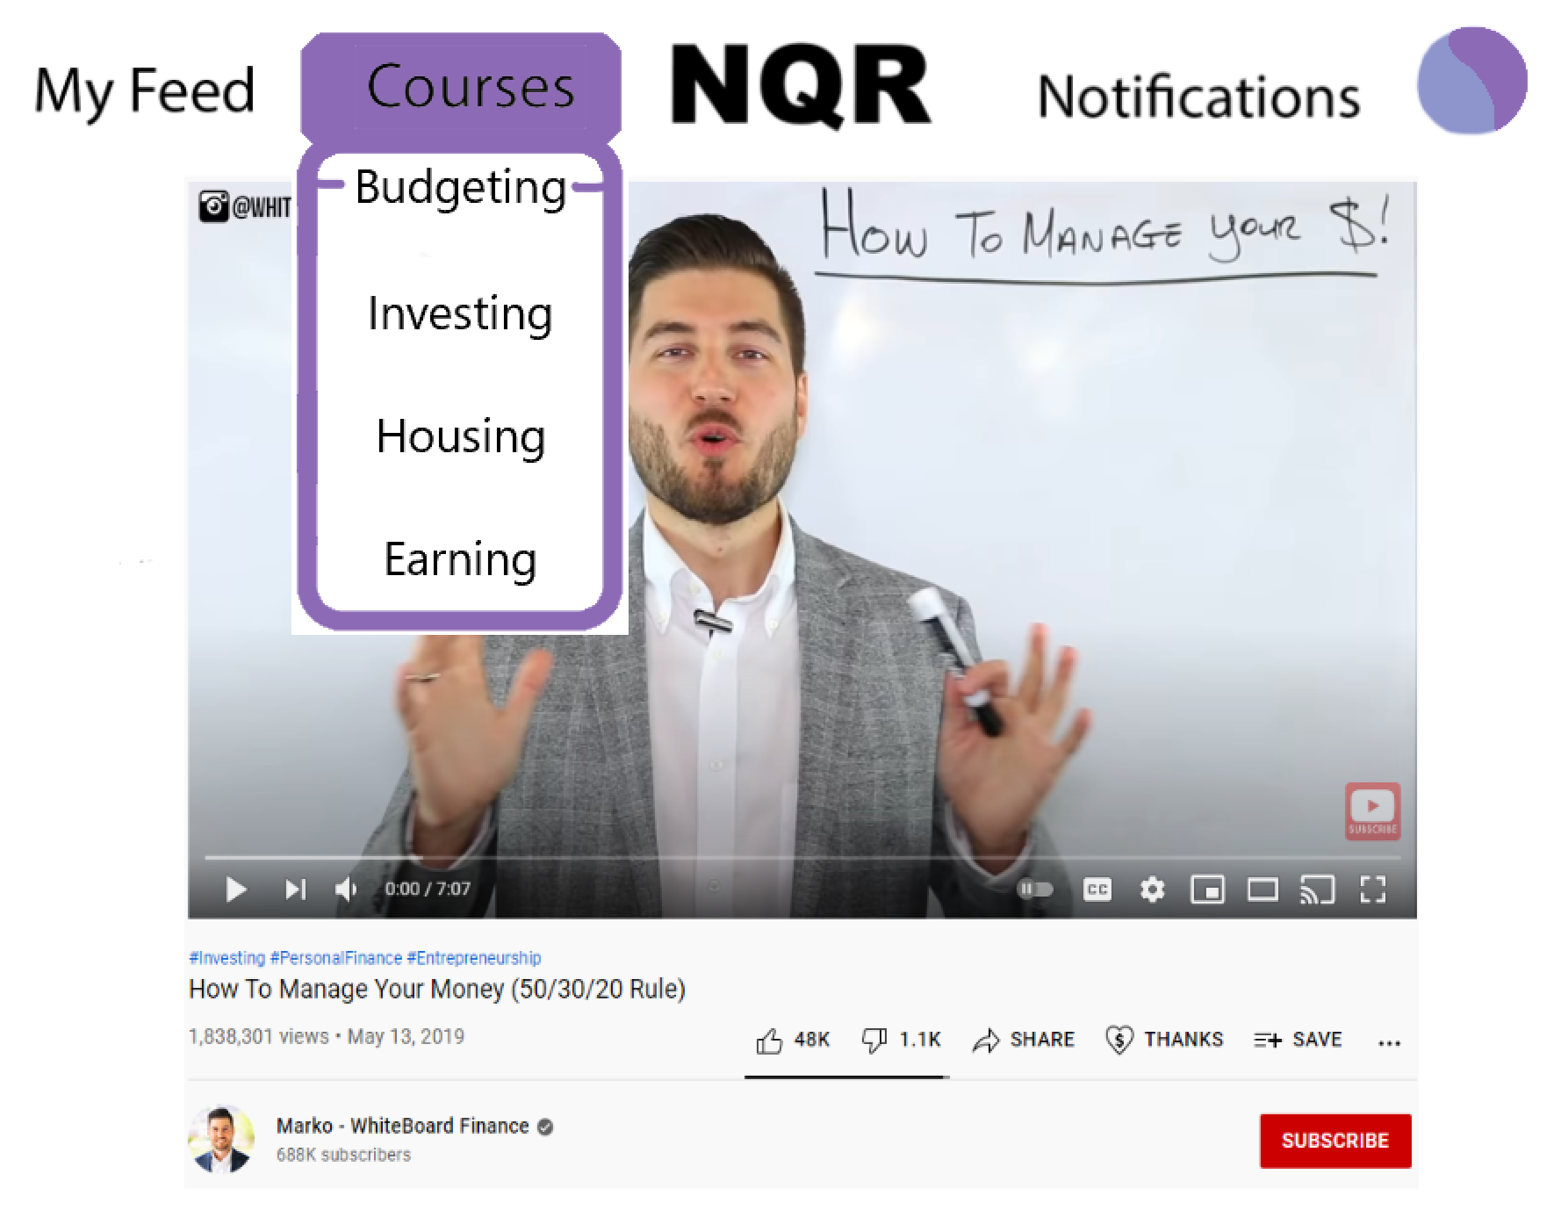
Creating Personal Budgets
Identifying sources of revenue and expenses and using that information to create monthly plans
Teaching how to incorporate debt (student/home loans, credit cards, etc.) into financial plans

Slide 13
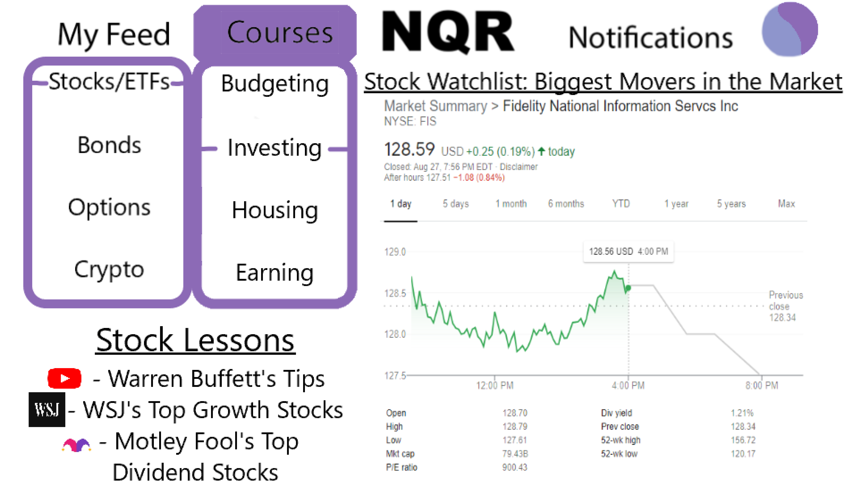
Learning about investing
Modules teaching about the following forms of investment:
Stocks/ETFs
Bonds
Options
Futures
Cryptocurrencies
Discuss advantages and disadvantages of each type

Slide 14
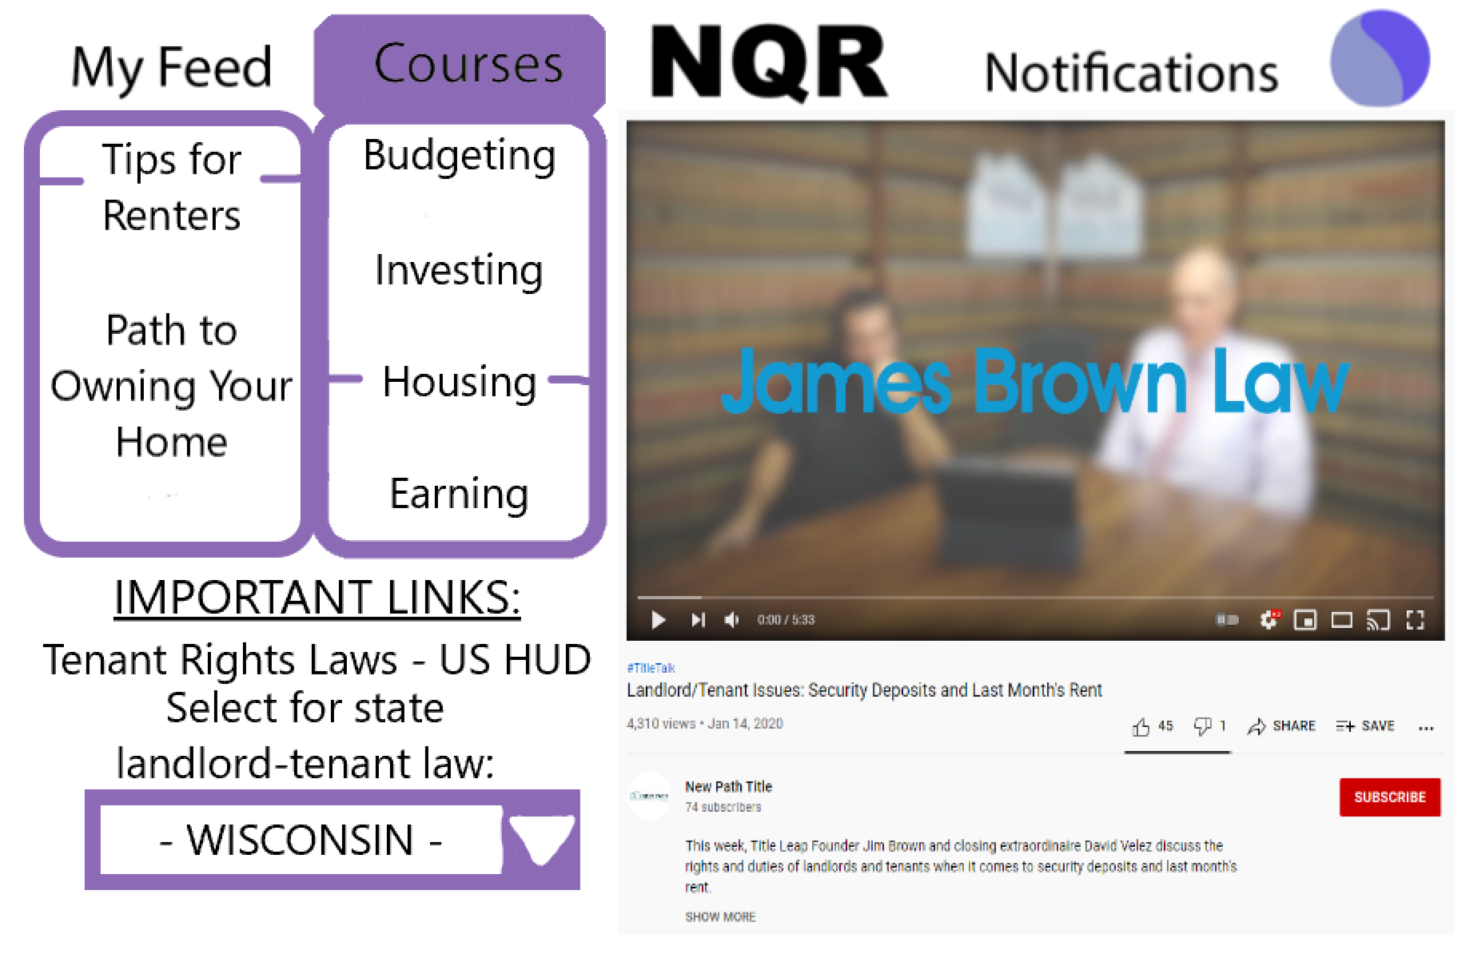
Minimizing housing costs and navigating toward home ownership
Common rule of thumb for real estate experts is that 30% of one’s income goes toward housing
Given the large expense housing is, the ability to minimize the expenses in that area is going to be of the utmost importance for renters
Notes:
Describe the rental market and path to home ownership briefly

Slide 15
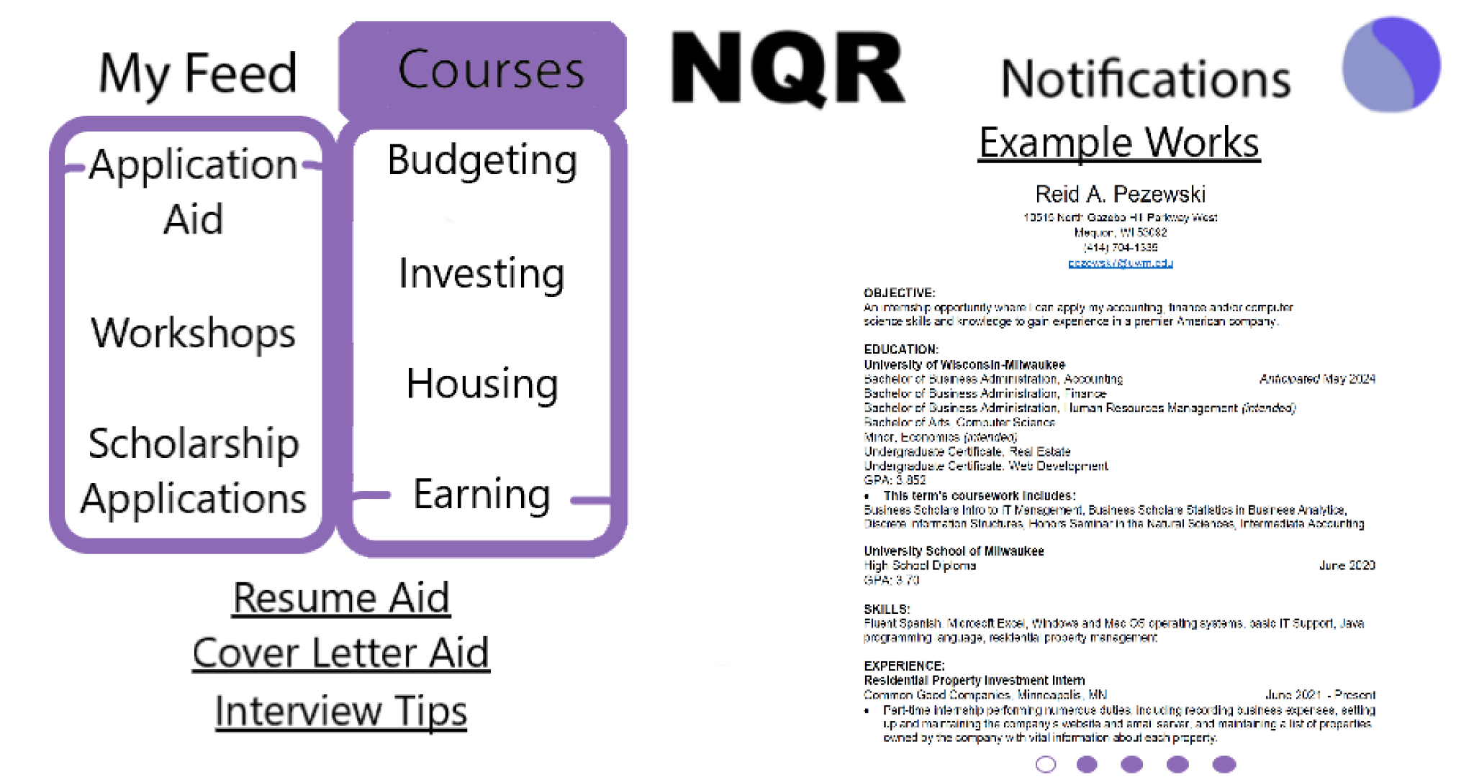
Maximizing earning potential
Although most of financial literacy comes from controlling expenses, enhancing revenue can also be beneficial
Career help offered:
Job interview, resume, cover letter assistance
Skills workshops useful to many companies
Small scholarships for users wishing to get a degree in STEM or Business

Slide 16
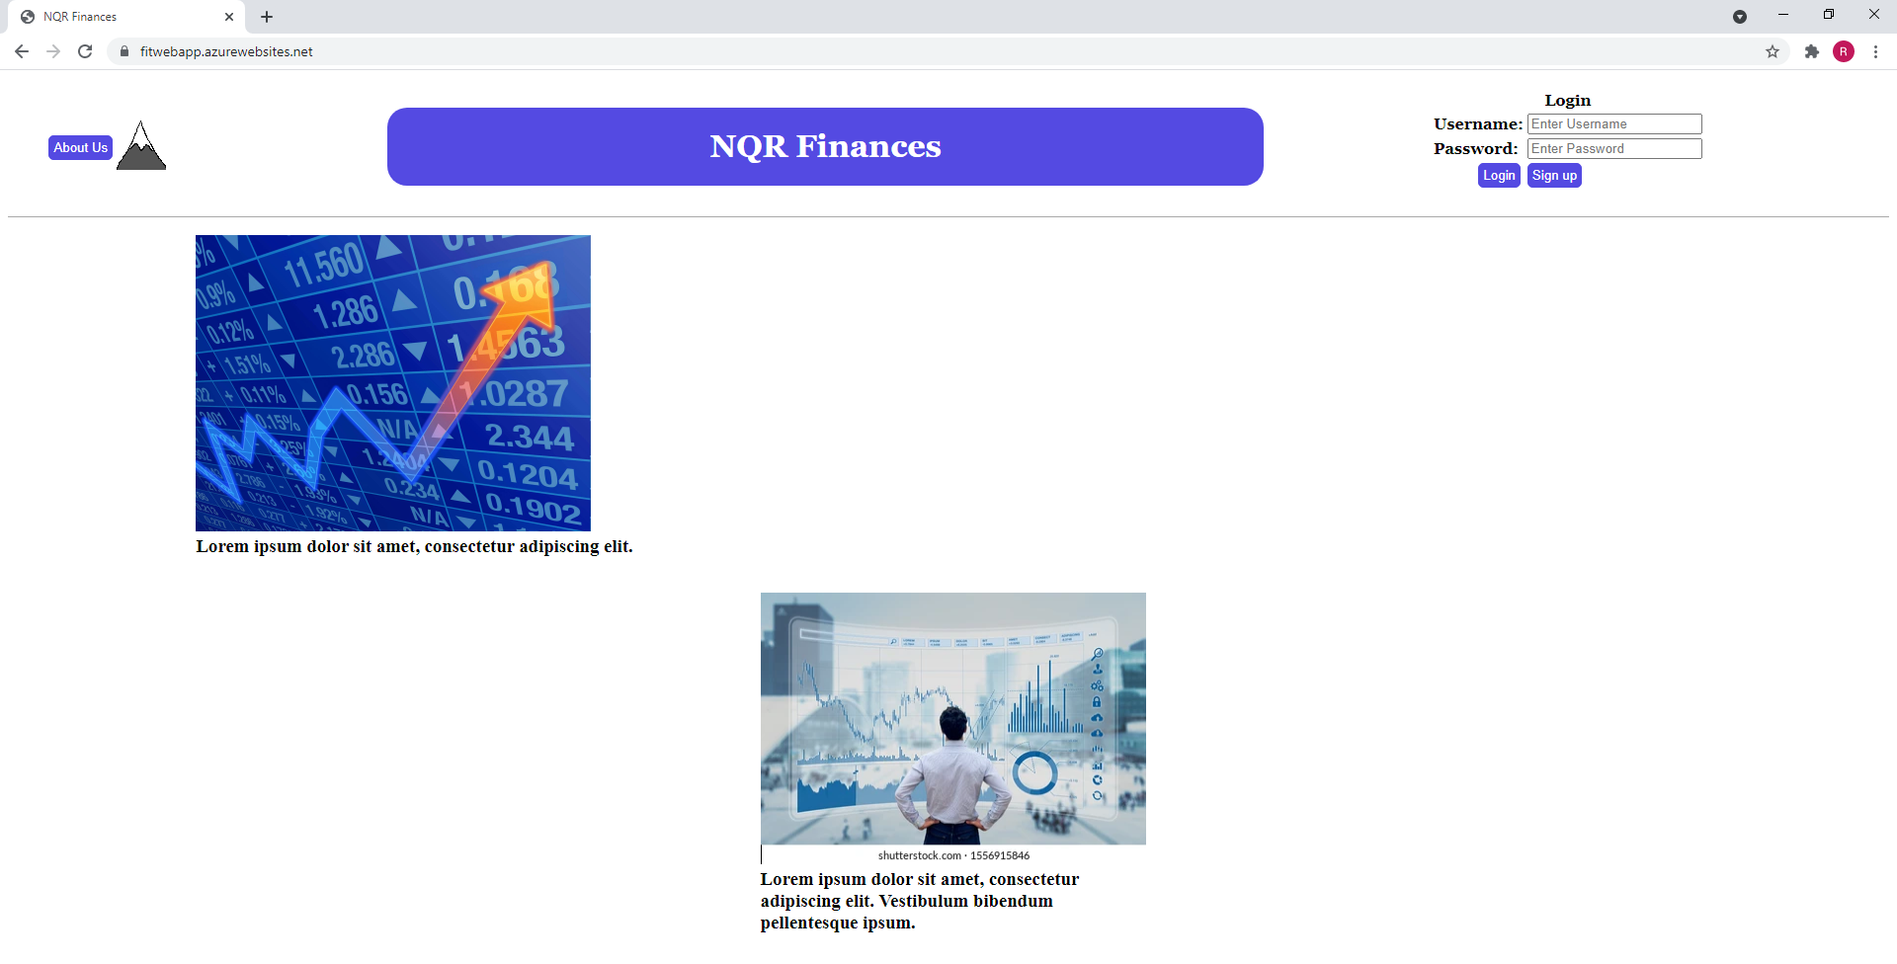
Final Product: Website
https://fitwebapp.scm.azurewebsites.net/

Slide 17
Questions?

Slide 18
Sources
https://www.nasfaa.org/news-item/14855/Survey_Incoming_College_Students_Struggle_With_Basic_Financial_Literacy
https://toolkit.nefe.org/evaluation-resources/evaluation-perspectives/financial-education-groups/young-adults
https://toolkit.nefe.org/evaluation-resources/evaluation-perspectives/financial-education-groups/working-adults

